Slide 1

Principles of Microeconomics Session 3: Crazy Rich Asians (Consumption 2)
Associate Professor Jonathan Tan
j.tan@ntu.edu.sg

Slide 2
Session outline
Consumer behavior
Utility and indifference curves
Budget constraints and budget lines
Bliss! Constrained optimization
Notes:
This session presents a model of consumer choice, explains how we use it to analyze and predict behavior under different conditions.

Slide 3


Budget Constraints
Let F be the amount of food purchased, C is the amount of clothing.
Income = I, price of food = P_{F} and price of clothing = P_{C}
Then P_{F}F is the amount of money spent on food, and P_{C}C is the amount of money spent on clothing.
Between Astrid and me, which variable is different?
Notes:
48
42

Slide 4
Drawing the budget line

Slide 5
The Budget Line - intercepts
Clothing (Y)
P_{F} = $1, P_{C} = $2, I = 80
A
(I/P_{C}) = 40
If the consumer spends I on only C, then she can consume I/P_{C} = 80/2 = 40 units of C (point A)
If the consumer spends I on only F, then she can consume I/P_{F} = 80/1 = 80 units of F (point G)
Between A and G, many other linear combinations of C and F are feasible
B
30
D
20
E
10
G
Food (X)
0
20
40
60
80 = (I/P_{F})
Notes:
54
42

Slide 6
The Budget Line - slope
Clothing (Y)
P_{F} = $1, P_{C} = $2, I = 80
A
(I/P_{C}) = 40
The slope of the budget line measures the relative cost of food and clothing.
The consumer must give up 10 units of Y to obtain 20 units of X
The consumer must give up 1/2 unit of Y to obtain 1 unit of X
B
30
10
D
20
20
E
10
G
Food (X)
0
20
40
60
80 = (I/P_{F})
Notes:
54
42

Slide 7
Changing prices and income

Slide 8
The Budget Line – Income Changes
Clothing
(units
per week)
A increase in
income shifts
the budget line
outward
80
60
A decrease in
income shifts
the budget line
inward
40
20
L₃
(I =
$40)
L₁
L₂
(I = $80)
(I = $160)
Food
(units per week)
0
40
80
120
160
Notes:
61
42

Slide 9
The Budget Line – Price Changes
Clothing
(units
per week)
An increase in the
price of food to
$2.00 changes
the slope of the
budget line and
rotates it inward.
A decrease in the
price of food to
$.50 changes
the slope of the
budget line and
rotates it outward.
40
L₃
L₁
L₂
(P_{F} = 1)
(P_{F} = 1/2)
(P_{F} = 2)
Food
(units per week)
40
80
120
160
Notes:
65
42

Slide 10
Slope of the budget line

Slide 11

The Budget Line – method 1
Clothing (Y)
P_{F} = $1, P_{C} = $2, I = 80
A
(I/P_{C}) = 40
Slope = $\frac{∆Y}{∆X}$= $\frac{∆C}{∆F}=\frac{0−40}{80−0}=−\frac{1}{2}$
B
30
Y changes to 0 from 40 when X changes to 80 from 0.
D
@u: Does this look familiar? Is this “MRS”?
20
E
10
G
Food (X)
0
20
40
60
80 = (I/P_{F})
Notes:
54
42

Slide 12
The Budget Line – specification
@u: what’s this formula about?
y = a + bx

Slide 13

The Budget Line – method 2
Clothing (Y)
P_{F} = $1, P_{C} = $2, I = 80
A
(I/P_{C}) = 40
y = a + bx tells us that y decreases by b as x changes by 1 (b < 0)
B
30
Slope $=−\frac{P_{F}}{P_{C}} =−\frac{1}{2}$
D
20
80/2 – ½ * 40 = 20
E
10
G
Food (X)
0
20
40
60
80 = (I/P_{F})
Notes:
54
42

Slide 14

The Budget Line – methods 1 and 2
Clothing (Y)
A
(I/P_{C}) = 40
Slope = $\frac{∆Y}{∆X}$= $\frac{∆C}{∆F}=−\frac{P_{F}}{P_{C}} =−\frac{1}{2}$
B
30
D
20
E
10
G
Food (X)
0
20
40
60
80 = (I/P_{F})
Notes:
54
42

Slide 15
Utility maximization

Slide 16
The bliss point where the indifference curve and budget line intersect locates the bundle of goods that gives the consumer maximum utility, given her preferences and subject to (s.t.) her budget constraint.
Clothing
B=Optimum
D=unfeasible
C=unfeasible
I₃
I₂
A=suboptimal
I₁
Budget constraint
0
Food

Slide 17
@u: At the bliss point
What is the formula for the slope of the budget line?
What is the formula for MRS?
What does tangency imply for the slopes of the budget line and IC?
How do we work out the optimal consumption bundle?

Slide 18
Recall that… Marginal rate of substitution
We measure how a person trades one good for another using the marginal rate of substitution (MRS)
It quantifies the amount of one good a consumer will give up to obtain more of another good.
It is measured by the slope of the indifference curve.
Terminology: The MRS of food F for clothing C is the amount of clothing that a person is willing to give up to obtain one additional unit of food
Notes:
29

Slide 19

Recall that… Marginal Rate of Substitution
Clothing
16
A
14
MRS = 6
12
-6
10
B
1
8
-4
D
Remember that $∆C$ is always negative!
6
MRS = 2
1
-2
E
4
G
1
-1
2
1
Food
1
2
3
4
5
Notes:
32

Slide 20

Satisfaction is maximized when marginal rate of substitution (of F and C) is equal to the ratio of the prices (of F and C)
The MRS is the negative slope of an indifference curve, which is
The slope of the budget line is
Slope = $\frac{∆C}{∆F}=−\frac{P_{F}}{P_{C}}$
Therefore at the consumer’s optimal consumption point
Notes:
70

Slide 21
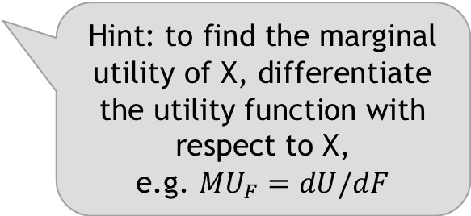
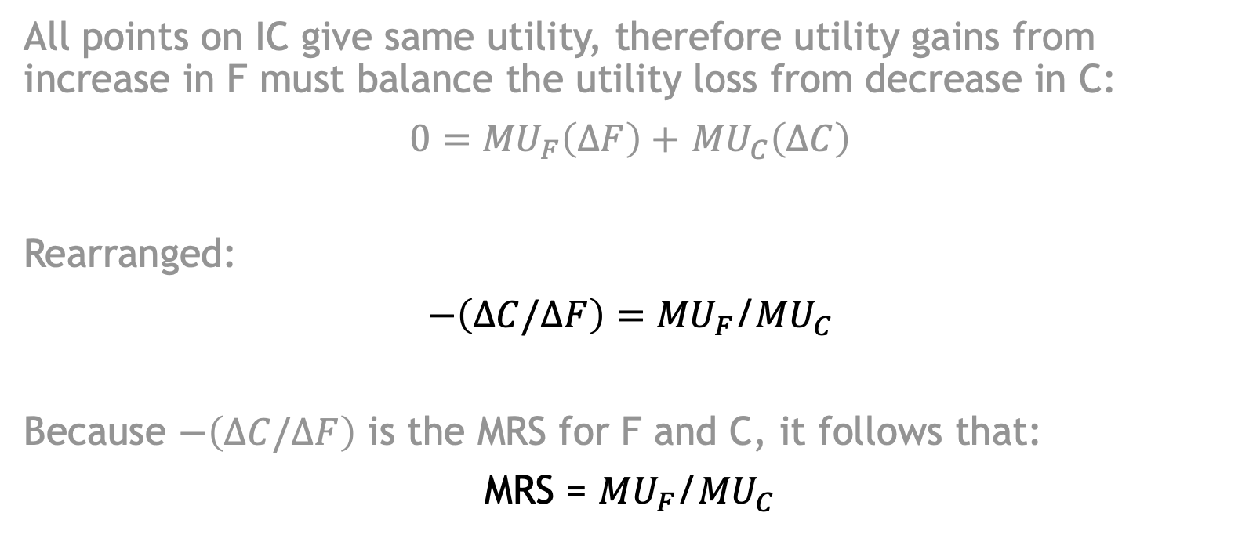
Recall that…
All points on IC give same utility, therefore utility gains from increase in F must balance the utility loss from decrease in C:
$0={MU}_{F}\left(∆F\right)+$ ${MU}_{C}\left(∆C\right)$
Rearranged:
$−\left(∆C/∆F\right)={MU}_{F}$/${MU}_{C}$
Because $−\left(∆C/∆F\right)$ is the MRS for F and C, it follows that:
MRS = ${MU}_{F}$/${MU}_{C}$
Hint: to find the marginal utility of X, differentiate the utility function with respect to X,
e.g. ${MU}_{F}=dU/dF$

Slide 22
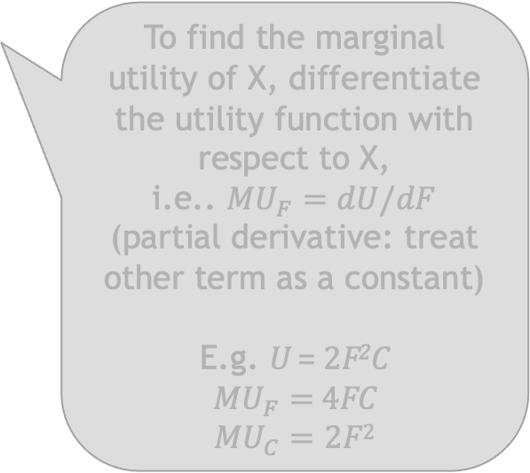

Recall that… Deriving MRS from utility functions
All points on IC give same utility, therefore utility gains from increase in F must balance the utility loss from decrease in C:
$0={MU}_{F}\left(∆F\right)+$ ${MU}_{C}\left(∆C\right)$
Rearranged:
$−\left(∆C/∆F\right)={MU}_{F}$/${MU}_{C}$
Because $−\left(∆C/∆F\right)$ is the MRS for F and C, it follows that:
MRS = ${MU}_{F}$/${MU}_{C}$
To find the marginal utility of X, differentiate the utility function with respect to X,
i.e.. ${MU}_{F}=dU/dF$
(partial derivative: treat other term as a constant)
E.g. U = 2F²C
${MU}_{F}=$ 4FC
$${MU}_{C}=2F2$$

Slide 23
Equal marginal principle
At the consumer’s optimal consumption point
Utility is maximized when the marginal utility per dollar spent (i.e. “bang for buck”) across all goods is equalized
MRS = MU_{F}/MU_{C} = P_{F}/P_{C}
=> MU_{F}/P_{F} = MU_{C}/P_{C}
Notes:
70

Slide 24
Example – 1) MRS = slope of budget line
U = 2X^{0.5}Y^{0.5}
P_{X} = 1, P_{Y} = 2, I = 80
MRS = MU_{X}/MU_{Y}
MU_{X} = dU/dX = (2*0.5)X^{(0.5-1)}Y^{0.5} = X^{-0.5}Y^{0.5} = Y^{0.5}/X^{0.5}
MU_{Y} = dU/dY = (2*0.5)X^{0.5}Y^{(0.5-1)} = X^{0.5}Y^{-0.5} = X^{0.5}/Y^{0.5}
MU_{X}/MU_{Y} = Y/X
MRS = P_{X}/P_{Y} = ½
P_{X}/P_{Y} = ½
Y/X = ½
Y = X/2
=> buy ½ as much Y as X

Slide 25
Example – alternatively
MU_{X}/P_{X} = MU_{Y}/P_{Y}
(Y^{0.5}/X^{0.5})/1 = (X^{0.5}/Y^{0.5})/2
(Y^{0.5}/X^{0.5})/1 = (X^{0.5}/2Y^{0.5})
Y = X/2

Slide 26
Example – 2) optimal consumption bundle
I = P_{x}X + P_{y}Y
80 = 1X + 2Y
Substitute Y with X/2
80 = 1X + 2(X/2)
80 = 1X + 1X
80 = 2X
X = 40
Y = X/2 = 40/2
Y = 20

Slide 27
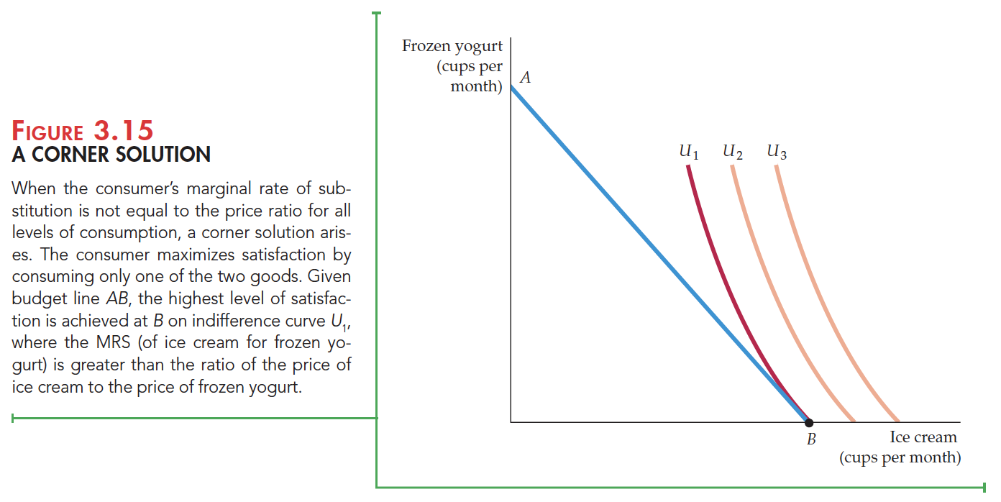

Corner solutions – no tangency
“I am ok with yogurt but love ice cream much more!”
Corner solution MRS $≥$ P_{ice}/P_{yog}
@u: What other examples can you think of?
Hint: previous problem set

